Slide 1
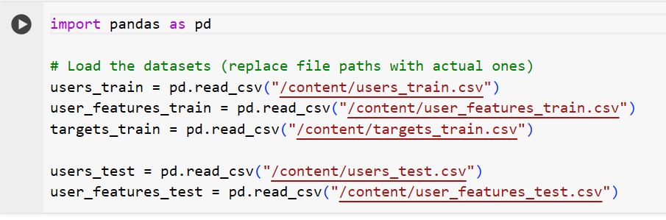
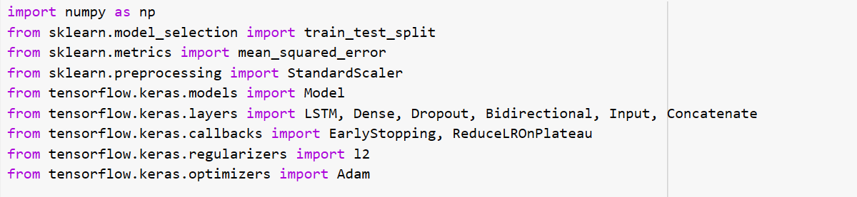
Data loading
Training Data Loading
Test Data Loading
Importing Libraries
LSTM
Neural Network Advantages
Advanced time series data analysis
Standart Scalar
Standartzing the data
Speeding up convergence

Slide 2
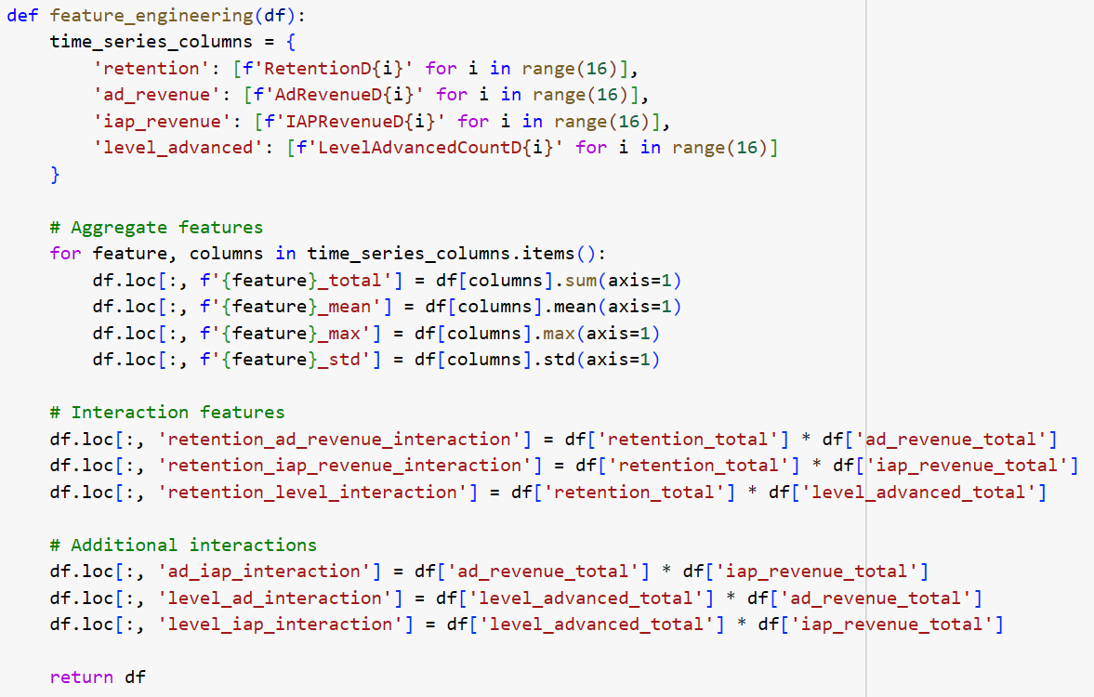
Feature engineering
Feature selection
RFE (Recursive Feature Elimination)
Chose the most influential data
Aggregate features
Synthesizing meaningful data from the existing dataset
Creating new features
Utilized the most important columns
Created relevant and important columns

Slide 3
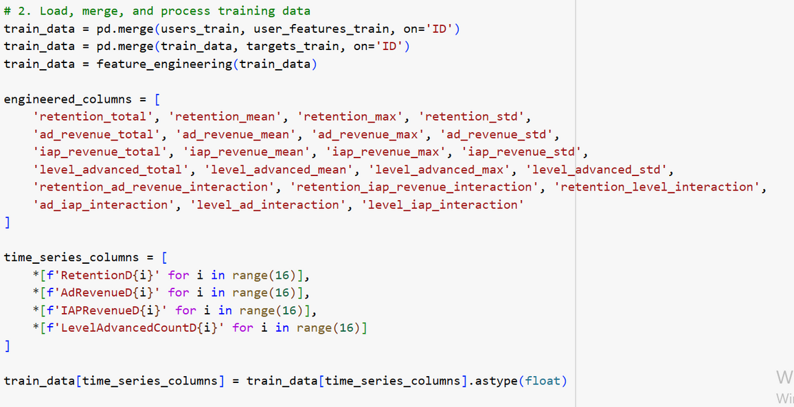
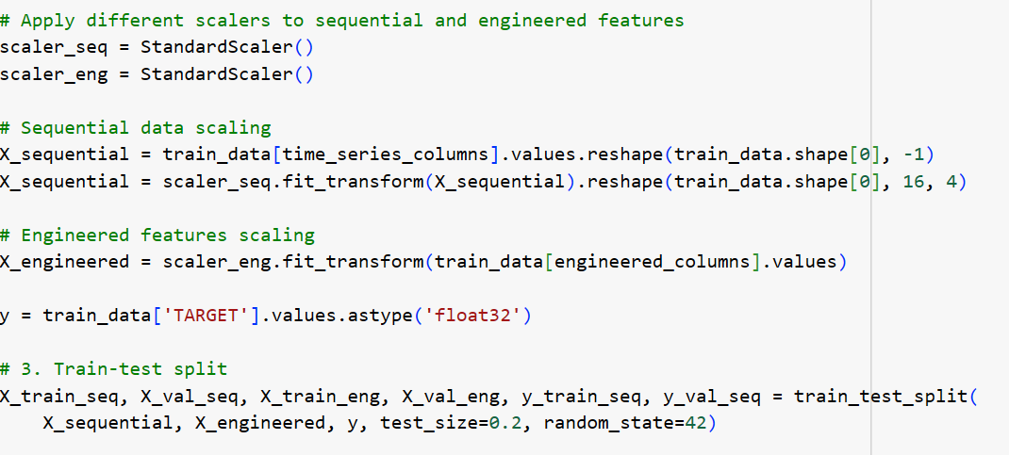
Data loading
Merging and processing data
Creating Time Series Columns
Importing Libraries
Standard Scalar
Standartizing data for better results
Scaling Data

Slide 4
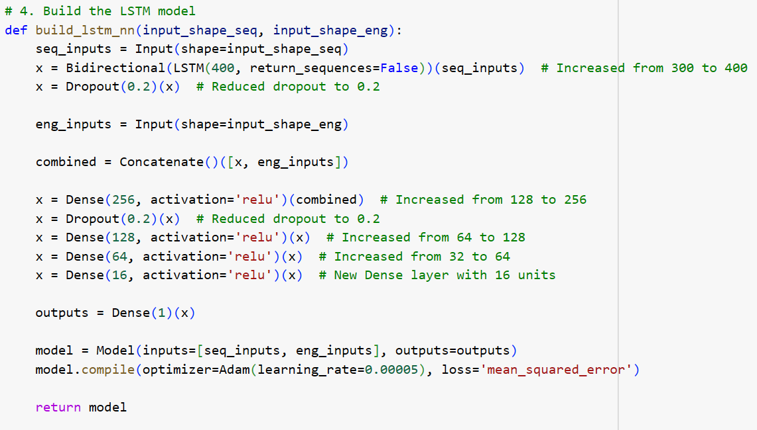
Train-Test Split
Training/Valid Sets
Model Implementation
LSTM
Biderectional
4 Layers
Adam optimizer
Dropout = 0.2

Slide 5
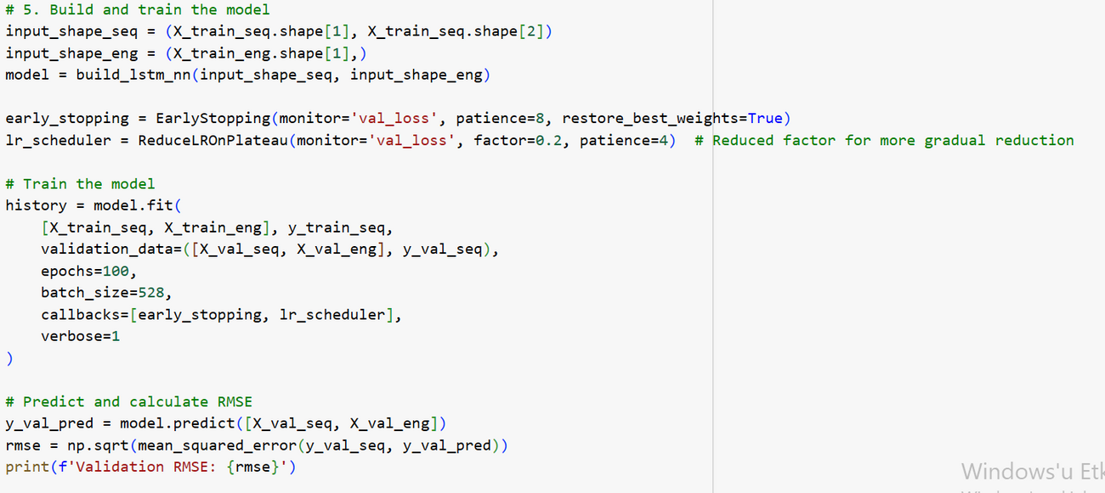
Training model
Early Stopping
Patience = 8
Batch Size/Epochs
Faster convergence
Through training
Validating model

Slide 6
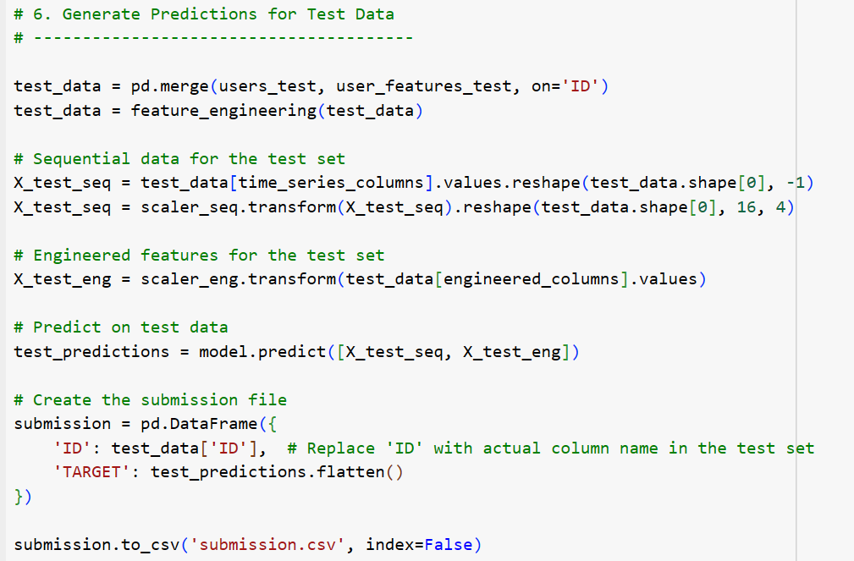
Predictions
Loading test data
Sequential and Engineered Feature Creation
Prediction and Submission file

Slide 7
Result
1.42 RMSE
2nd place
Key Points of the Model
Adaptable Architecture
Fast training process
Fine-tuned Performance

